Slide 1

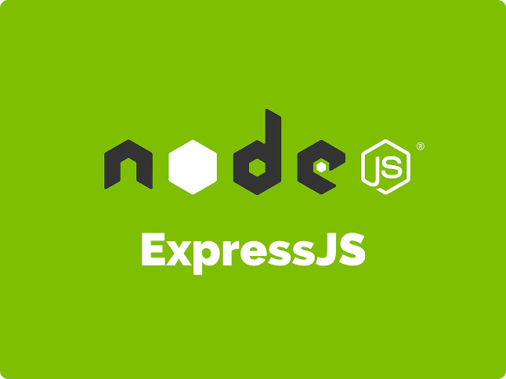


Introduction to Express.js
"A route" refers to a path or endpoint that the server responds to, along with the HTTP method (GET, POST, PUT, DELETE, etc.) that is associated with that path. When a client makes a request to a specific route, Express.js matches that request to the corresponding route handler, which is a function that defines how the server should respond.
by Vivek Singh Parmar

Slide 2
Understanding Route Parameters
Dynamic Routes
Accessing Parameters
Validation and Handling
Express.js allows you to create dynamic routes using parameters. These parameters are extracted from the URL and can be used to customize the response.
Parameters are accessible through the `req.params` object in your route handlers. This allows you to build flexible and scalable APIs.
It's important to validate and handle parameters to ensure your application's security and reliability.

Slide 3

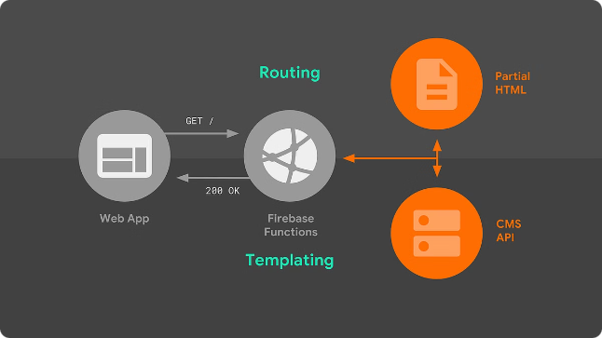
Defining Route Handlers
Function Signatures
Handling Logic
Route handlers in Express.js are defined as functions that accept the request (req) and response (res) objects.
Route handlers contain the logic to process the incoming request and generate the appropriate response.
Middleware Integration
Modularity
Route handlers can also utilize middleware functions to extend their functionality and share common logic.
Organizing route handlers in a modular fashion can improve the maintainability and scalability of your Express.js application.

Slide 4

Handling HTTP Methods
GET
PUT/PATCH
The GET method is used to retrieve data from the server.
The PUT and PATCH methods are used to update existing data on the server.
1
2
3
4
POST
DELETE
The POST method is used to submit new data to the server.
The DELETE method is used to remove data from the server.

Slide 5

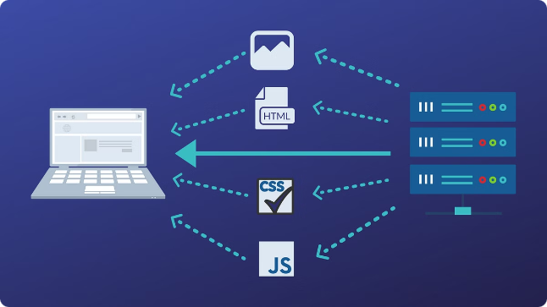
Sending Responses with Express
1
res.send()
2
res.json()
Sends a simple text or HTML response.
Sends a JSON response.
3
res.status()
4
res.redirect()
Sets the HTTP status code of the response.
Redirects the client to a different URL.

Slide 6



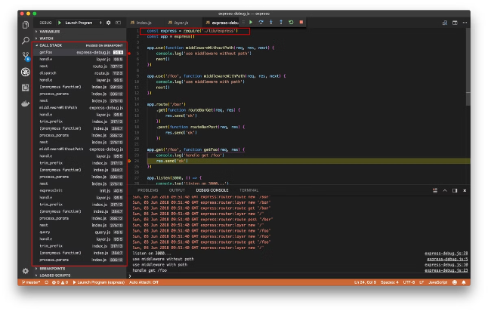


Customizing Response Headers
Content-Type
Cache-Control
Specifies the media type of the response body.
Controls how the response is cached by the client.
Access-Control-Allow-Origin
X-Powered-By
Identifies the technology used to power the application.
Specifies which origins are allowed to access the resource.

Slide 7





Redirecting Requests
Temporary Redirect
Use res.redirect() to temporarily redirect the client to a different URL.
Permanent Redirect
Use res.status(301).redirect() to permanently redirect the client to a new URL.
Relative Paths
Redirects can use relative paths to redirect to other routes within the application.

Slide 8

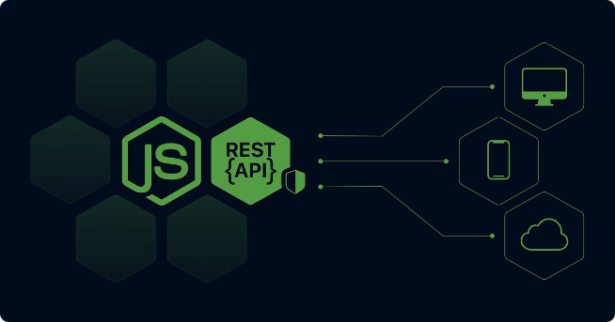
Conclusion and Best Practices
Use Middleware
Leverage middleware functions to encapsulate common logic and improve code organization.
Validate Inputs
Carefully validate all user inputs to ensure the security and reliability of your application.
Error Handling
Implement robust error handling to provide meaningful feedback to users and facilitate debugging.
Modular Design
Organize your Express.js application in a modular fashion to improve scalability and maintainability.

